Slide 1
Secure Network Architecture Design
Ryan Coon

Slide 2
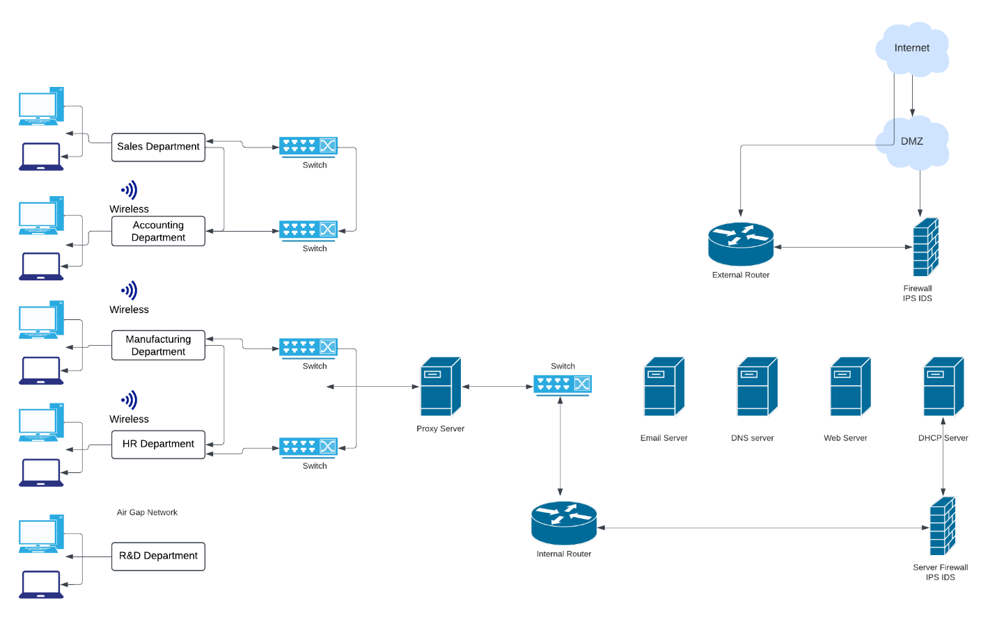

Slide 3


Slide 4
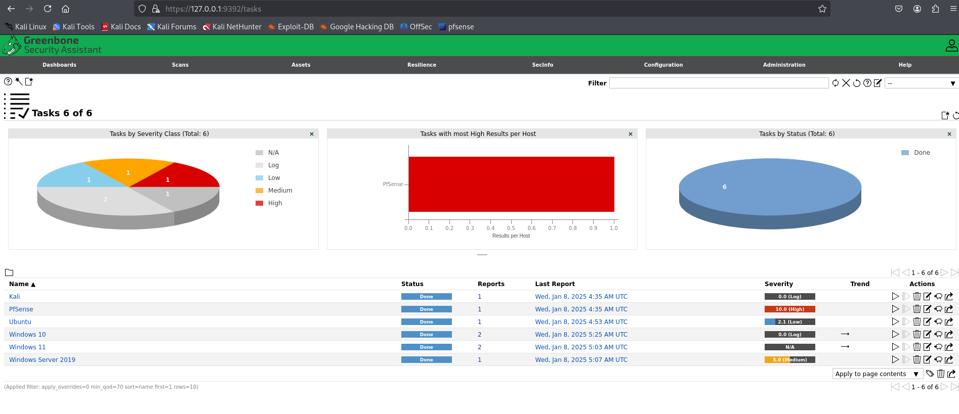

Slide 5
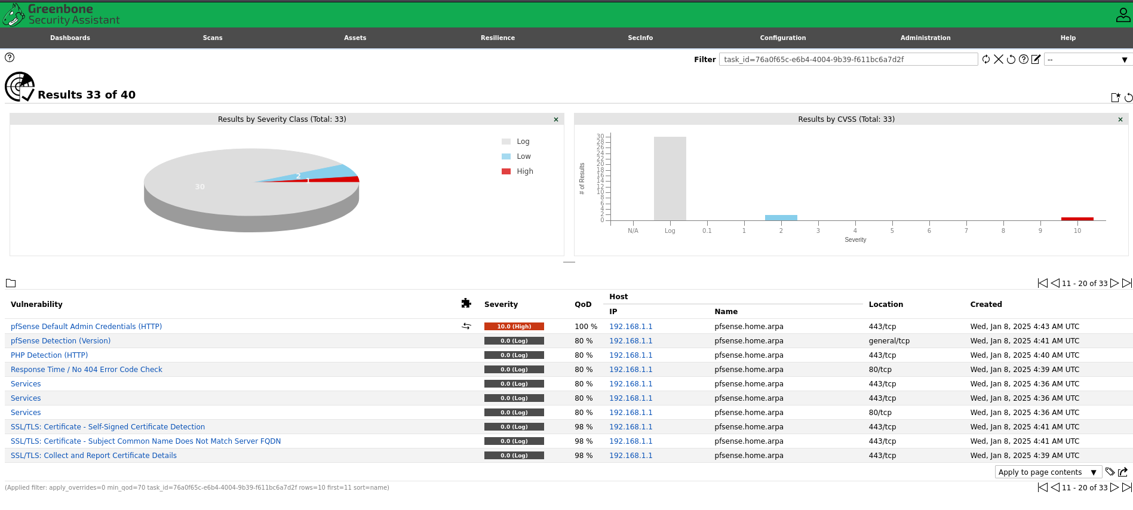

Slide 6
Advanced Networks and Security Issues
Increased Attack Surface
As networks become more complex with the integration of IoT devices, cloud services, and 5G technology, the potential entry points for cyberattacks increase. This expanded attack surface can lead to:
Vulnerabilities in IoT Devices: Many IoT devices lack robust security measures, making them easy targets for attackers.
Cloud Security Risks: Misconfigurations and inadequate access controls can expose sensitive data.
Sophistication of Cyberattacks
Cyberattacks are becoming increasingly sophisticated, utilizing advanced techniques such as:
Ransomware: Attackers encrypt data and demand payment for decryption, often targeting critical infrastructure.
Supply Chain Attacks: Compromising third-party vendors to infiltrate larger networks, as seen in high-profile breaches.

Slide 7
Advanced Networks and Security Issues
Protocol Vulnerabilities
New protocols, while designed to enhance performance and security, can introduce their own vulnerabilities. For example:
QUIC Protocol: While it improves latency and security, it may also expose new attack vectors if not properly implemented.
IPv6 Transition: The shift from IPv4 to IPv6 can lead to misconfigurations and security gaps if organizations are not fully prepared.
Remote Access Vulnerabilities
With the rise of remote work, securing remote access has become paramount. Key issues include:
VPN Security: Insecure VPN configurations can lead to unauthorized access.
Phishing Attacks: Increased reliance on remote access makes users more susceptible to phishing attempts.

Slide 8
Advanced Networks and Security Issues
. Data Privacy Concerns
As networks evolve, so do the regulations surrounding data privacy. Organizations must navigate:
Compliance with Regulations: Adhering to laws like GDPR and CCPA can be challenging, especially with cross-border data flows.
Data Breaches: The potential for data breaches increases with the complexity of networks, leading to significant financial and reputational damage.
Emerging Technologies and Their Implications
New technologies such as blockchain, AI, and quantum computing present both opportunities and challenges:
Blockchain: While it offers enhanced security for transactions, it can also be exploited if smart contracts are not properly coded.
AI in Cybersecurity: AI can help detect threats but can also be used by attackers to automate and enhance their attacks.

